Slide 1

Data Management, Table Formatting, and Basic Excel Functions
Speaker: Dr. Mobasher
Course: Data Visualization

Slide 2
Entering Data into Worksheets
Step 1: Click on a cell and type in data.
Step 2: Press Enter to move down, Tab to move right.
Step 3: Use Ctrl + Enter to stay in the same cell.
Tip: Double-click a cell to edit existing data.

Slide 3
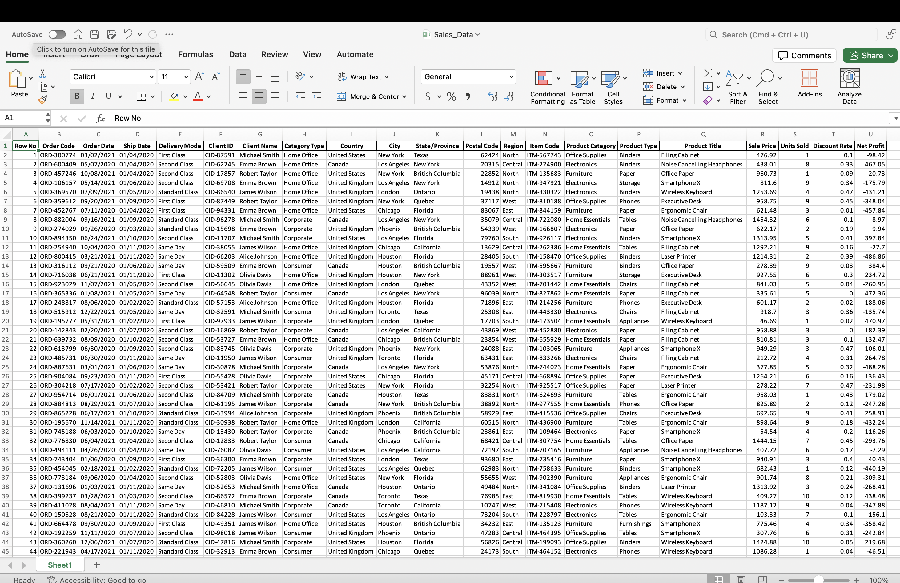
Open the excel file Sales_Data.xlsx in Excel > Data Folder for the rest of this lecture.

Slide 4
Freezing Panes, Rows, and Columns
Purpose: Keep headers visible when scrolling.
Steps to Freeze Top Row:
Open the excel file Office+Supplices.xls in Excel > Data Folder
Click on View tab.
Select Freeze Panes > Freeze Top Row.
Steps to Freeze First Column:
Click on View tab.
Select Freeze Panes > Freeze First Column.
To Freeze Both:
Select the cell below the row and to the right of the column you want to freeze.
Click Freeze Panes.

Slide 5
Handling Data: Rows and Columns
Selecting Data:
Click and drag to select a range.
Use Shift + Arrow keys for precise selection.
Copying & Moving Data:
Copy: Ctrl + C
Cut: Ctrl + X
Paste: Ctrl + V
Right-click for additional options.

Slide 6
Using Find and Replace
Purpose: Quickly locate and modify data.
Steps:
Press Ctrl + F to open Find.
Press Ctrl + H to open Replace.
Enter the search term and click Find Next or Replace All.

Slide 7
Sorting Data: Simple and Custom Options
Simple Sort:
Click on a column header.
Go to Data > Sort A to Z or Sort Z to A.
Custom Sort:
Click Sort in the Data tab.
Add multiple sort levels (e.g., sort by Region first, then by Sales).

Slide 8
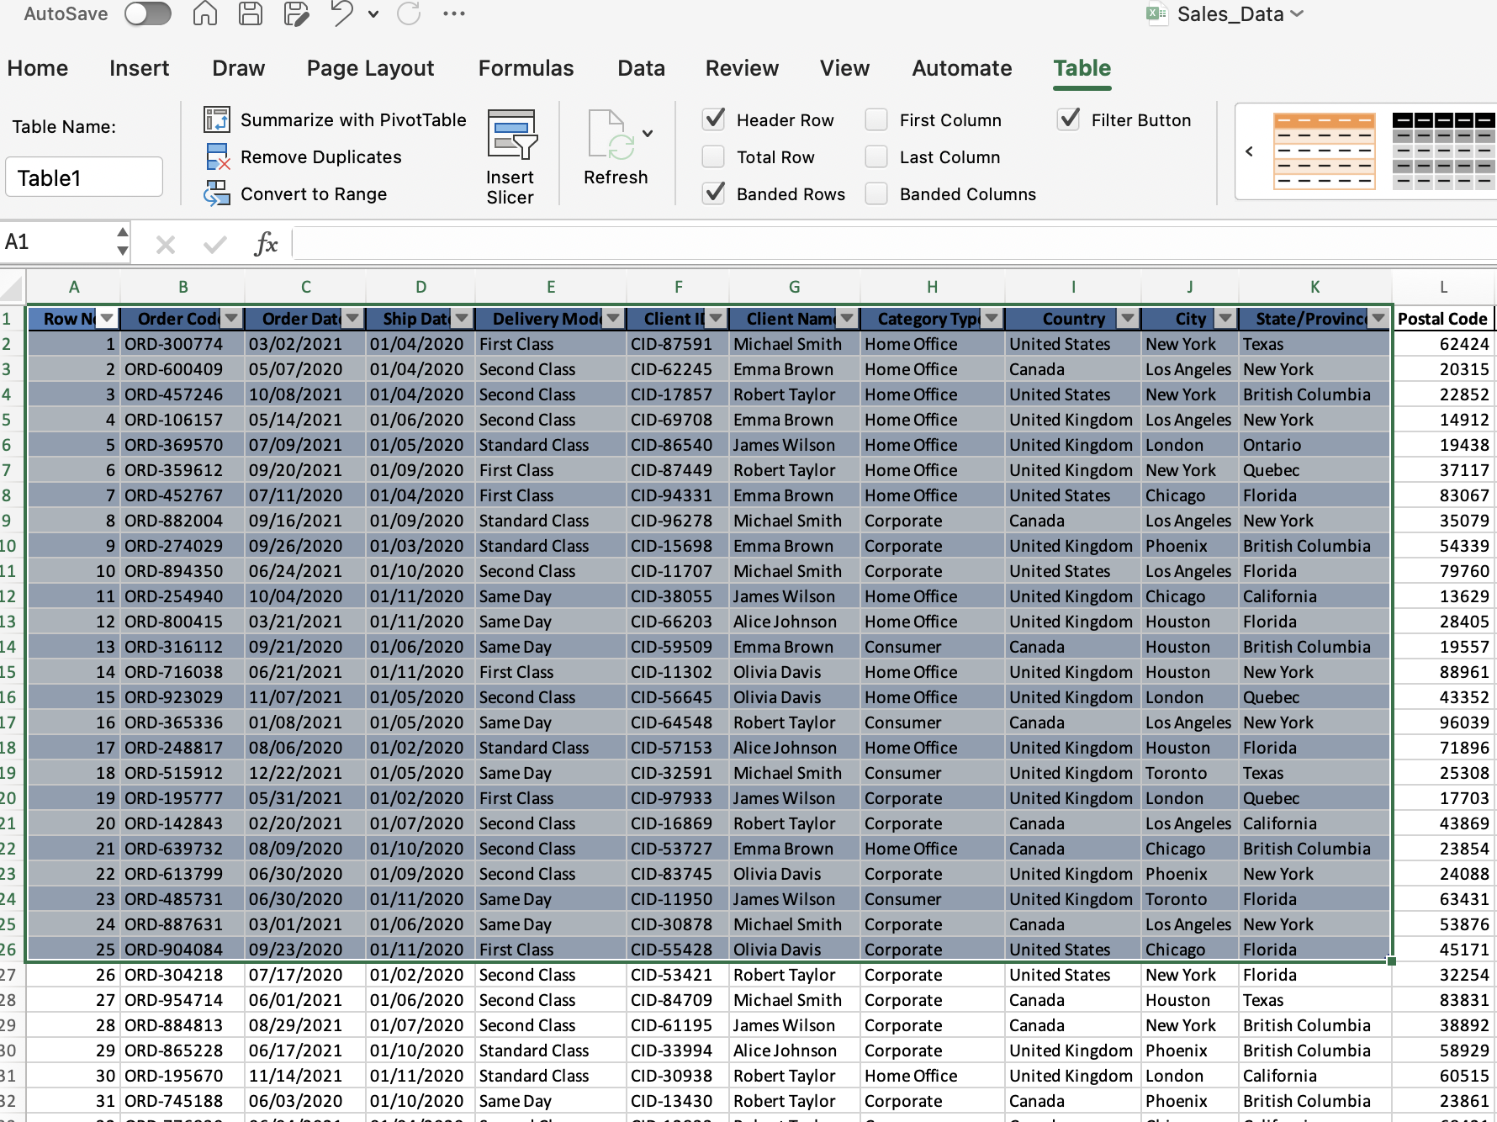
Table Setup and Filtering Data on the Table
Creating a Table:
Select the data range.
Click Insert > Table.
Ensure "My table has headers" is checked.
Applying Filters:
Click the dropdown in a column header.
Select filter criteria (e.g., only show sales > 1000).

Slide 9
Filtering Data Without Table Setup
You can also apply filtering on the whole dataset without setting up a table.
Steps to Apply Filtering:
Click on Data > Filter.
Use dropdown arrows to filter based on your criteria.
Benefits:
Allows quick sorting and filtering without modifying data structure.
Easy to remove by clicking Clear Filter under the Filter menu.

Slide 10
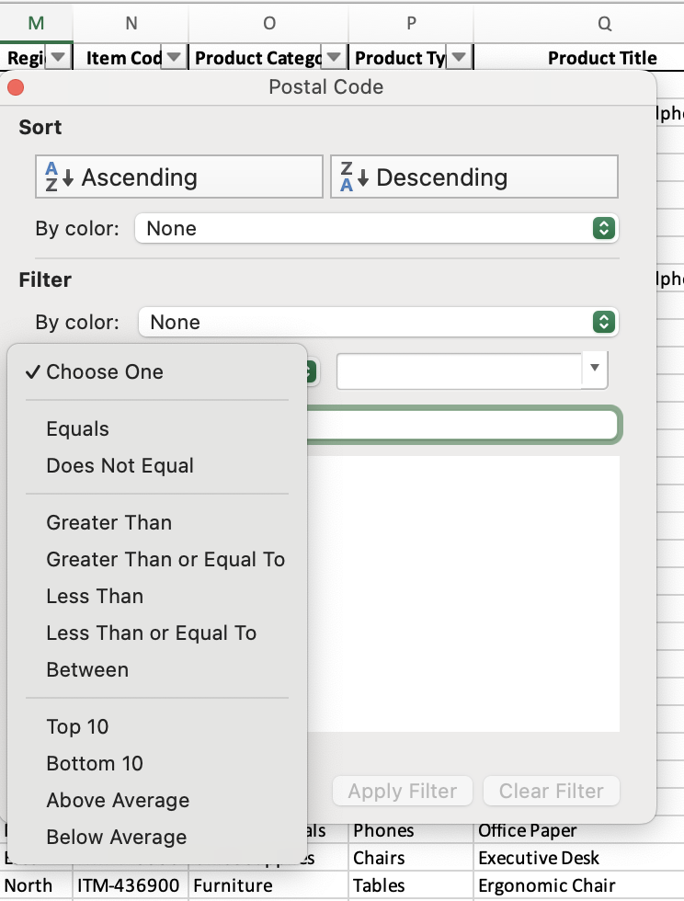
Filtering Data Without Table Setup
You can setup more advance filtering for each column
Steps to Apply Filtering:
Click on the tab Filter
Click on the column header
Click on the tab “Choose One”
For numerical columns you have the following filters actions to choose:
Equals, Does not Equal, Greater Than, Greater Than or Equal to, ….

Slide 11
Hiding and Organizing Columns and Rows
Hiding Data:
Right-click the column or row header and select Hide.
Unhiding Data:
Select adjacent columns/rows, right-click, and choose Unhide.
Grouping Data:
Select rows/columns, click Data > Group.
Grouping helps organize large datasets by collapsing and expanding sections.
Useful for summarizing data and improving navigation.
Helps in analyzing specific sections without deleting or hiding data.

Slide 12
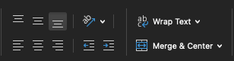
Adjusting and Formatting Text and Cells
Cell Alignment:
Use Home > Alignment options to adjust text.
Merging Cells:
Click Merge & Center to combine multiple cells.
Wrap Text:
Enables text to fit within a cell.
Alignment Options in Excel

Slide 13
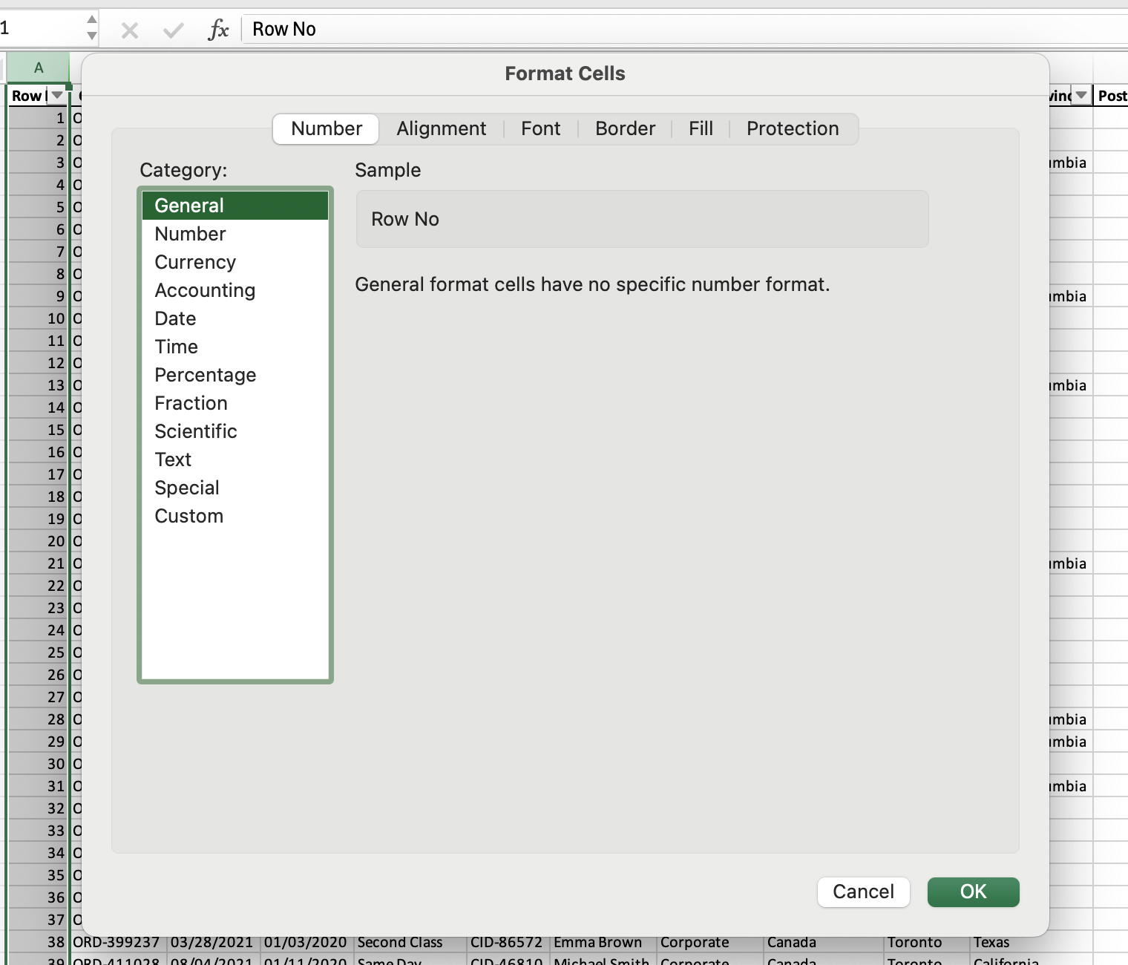
Introduction to Number Formatting
Types of Formatting:
General, Number, Currency, Date, Percentage.
How to Apply:
Right click on cells (or columns and rows by clicking on the header) and choose Format Cells (Ctrl + 1) from the dropdown.

Slide 14
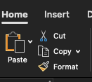
Using the Format Painter Tool
Steps to Use Format Painter:
Select a cell with the desired formatting.
Click Format Painter under the Home tab.
Click on the target cells to apply formatting.
Double-click Format Painter to apply formatting to multiple cells.
Press Esc to exit Format Painter mode.
Applies to:
Fonts, size, bold, italics, and number formatting.
Colors, cell styles, and alignment.

Slide 15
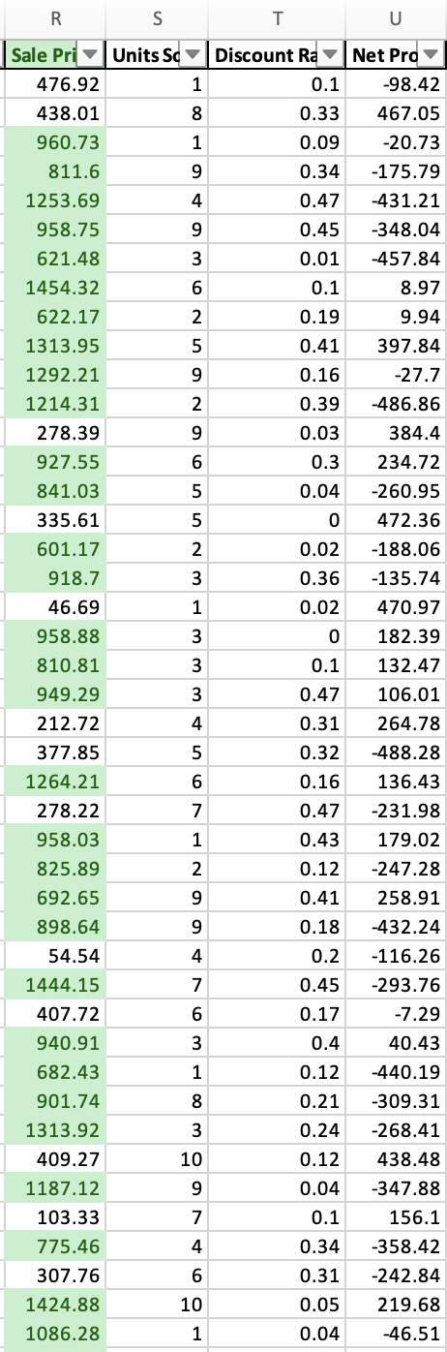
Conditional Formatting - Basics
Purpose: Highlight data trends and insights using visual cues.
Applying Conditional Formatting:
Select the range of data.
Click Conditional Formatting in the Home tab.
Choose a rule (e.g., Highlight Cells, Top/Bottom, Data Bars, Color Scales).
Click OK to apply.
Example: Highlight sales above a certain value (500 in this example) in green.

Slide 16
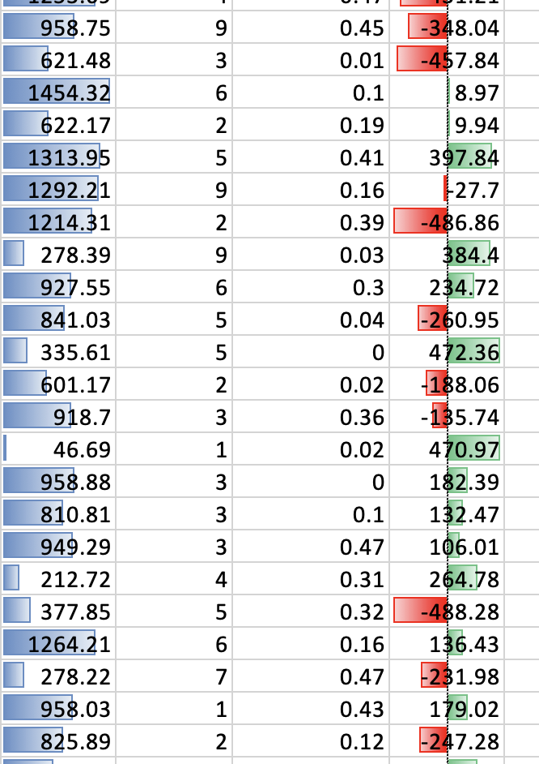
Applying Multiple Conditional Formats
Why use multiple conditional formats?
Provides deeper insights into data.
Enhances data representation.
Steps:
Select a numerical dataset.
Apply Data Bars from Conditional Formatting.
Apply Color Scales to add another layer of insight.
Example:
Data Bars show relative size.
Color Scales indicate positive and negative values.

Slide 17
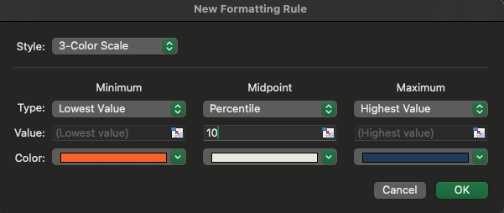
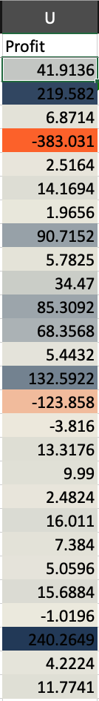
Custom Formatting Rules
Purpose: Apply formatting based on custom conditions.
Steps to Create a Custom Rule:
Select your dataset (e.g., sales and profit columns).
Click Conditional Formatting > New Rule.
Choose a rule type (e.g., Format cells based on values, Top/Bottom, or Standard Deviations).
Set thresholds and choose colors.
Click OK to apply.
Example: Apply a three-color scale to visualize profit distribution.

Slide 18
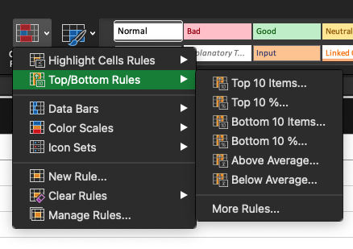
Using Conditional Formatting for Data Analysis
Advanced Rules:
Format only cells containing specific values.
Highlight duplicate or unique values.
Use formulas to define conditions.
Example: Highlight top 10% of sales and bottom 10% in different colors.
Practice: Apply different rules to explore insights in your dataset.

Slide 19
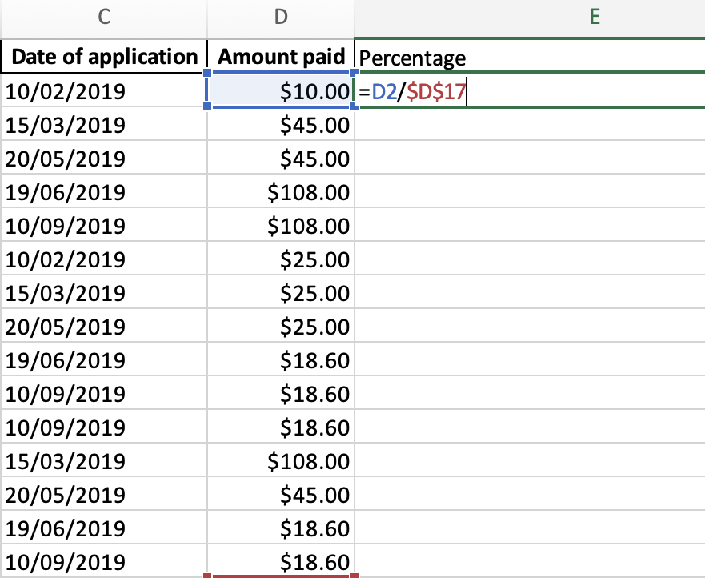
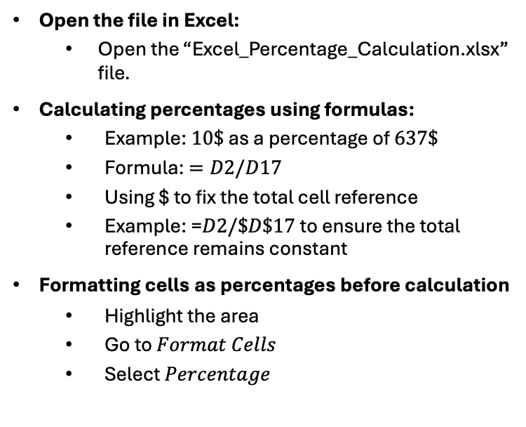
Working with Percentages and Absolute References
Open the file in Excel:
Open the “Excel_Percentage_Calculation.xlsx” file.
Calculating percentages using formulas:
Example: $10\$$ as a percentage of $637\$$
Formula: $=D2/D17$
Using $ to fix the total cell reference
Example: =$D2/\$D\$17$to ensure the total reference remains constant
Formatting cells as percentages before calculation
Highlight the area
Go to $Format Cells$
Select $Percentage$

Slide 20
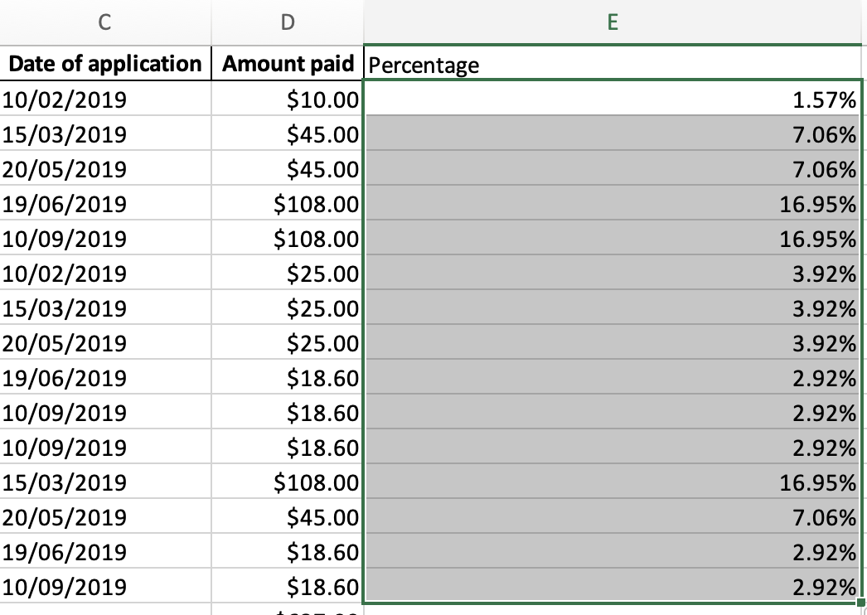
Working with Percentages and Absolute References
Copying formula to the rest of the cells
Select the cell that has the formula you want to fill into adjacent cells.
Drag the fill handle. across the cells that you want to fill.

Slide 21
Basic Functions in Excel
Excel provides several built-in functions to perform basic statistical calculations efficiently. In this presentation, we will cover commonly used functions like:
AVERAGE()
MAX()
MIN()
STDEV()
CORREL()
Practice: Open sample Excel files and apply the functions demonstrated in the following slides.

Slide 22
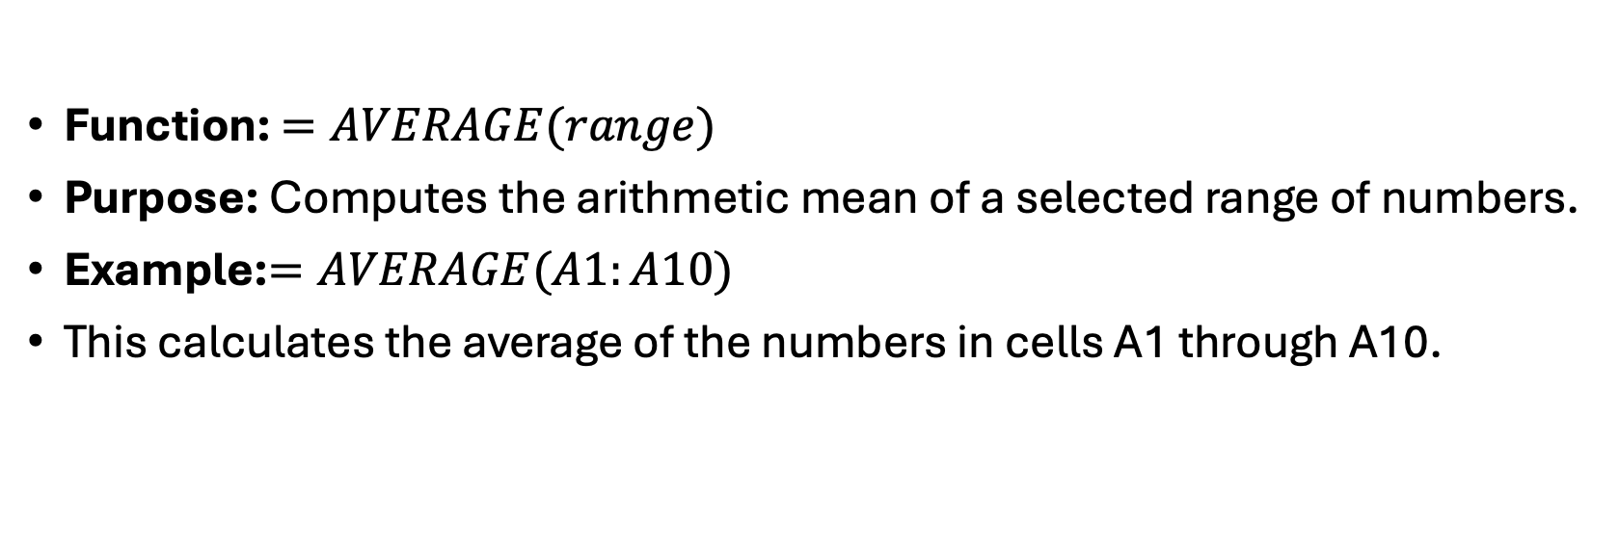
Calculating the Mean (Average)
Function: $=AVERAGE(range)$
Purpose: Computes the arithmetic mean of a selected range of numbers.
Example:$=AVERAGE(A1:A10)$
This calculates the average of the numbers in cells A1 through A10.

Slide 23
Finding the Maximum and Minimum Values
Maximum Function: =MAX(range)
Returns the largest value in the given range.
Example: =MAX(A1:A10)
Minimum Function: =MIN(range)
Returns the smallest value in the given range.
Example: =MIN(A1:A10)

Slide 24
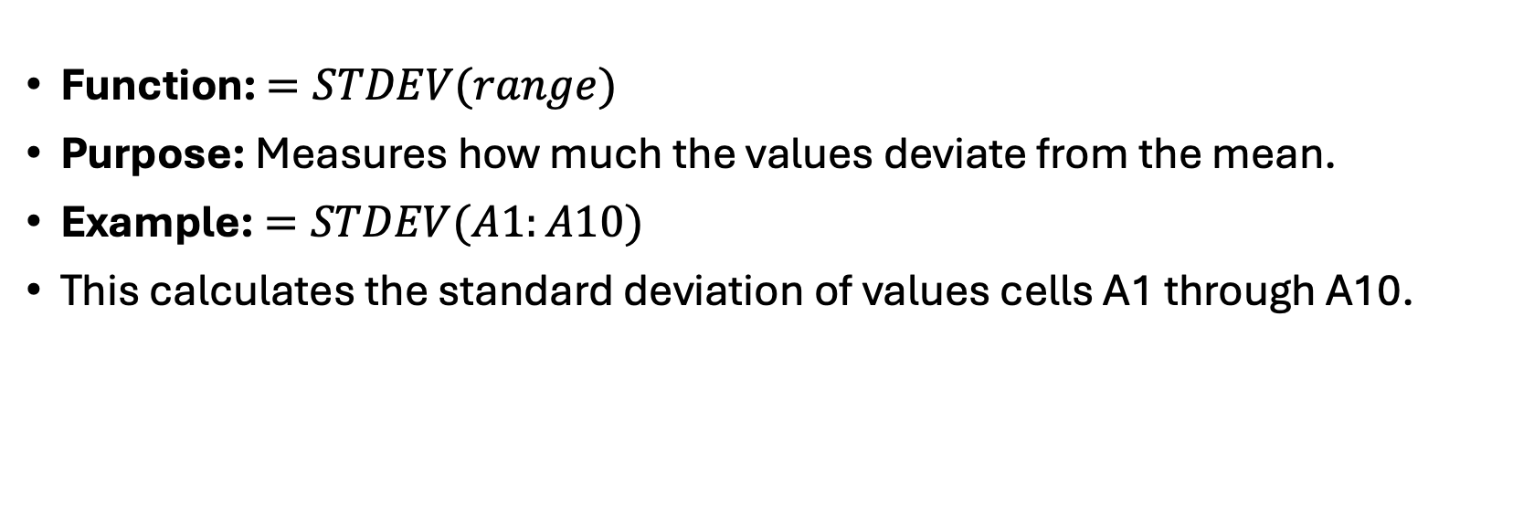
Standard Deviation
Function: $=STDEV(range)$
Purpose: Measures how much the values deviate from the mean.
Example:$=STDEV(A1:A10)$
This calculates the standard deviation of values cells A1 through A10.

Slide 25
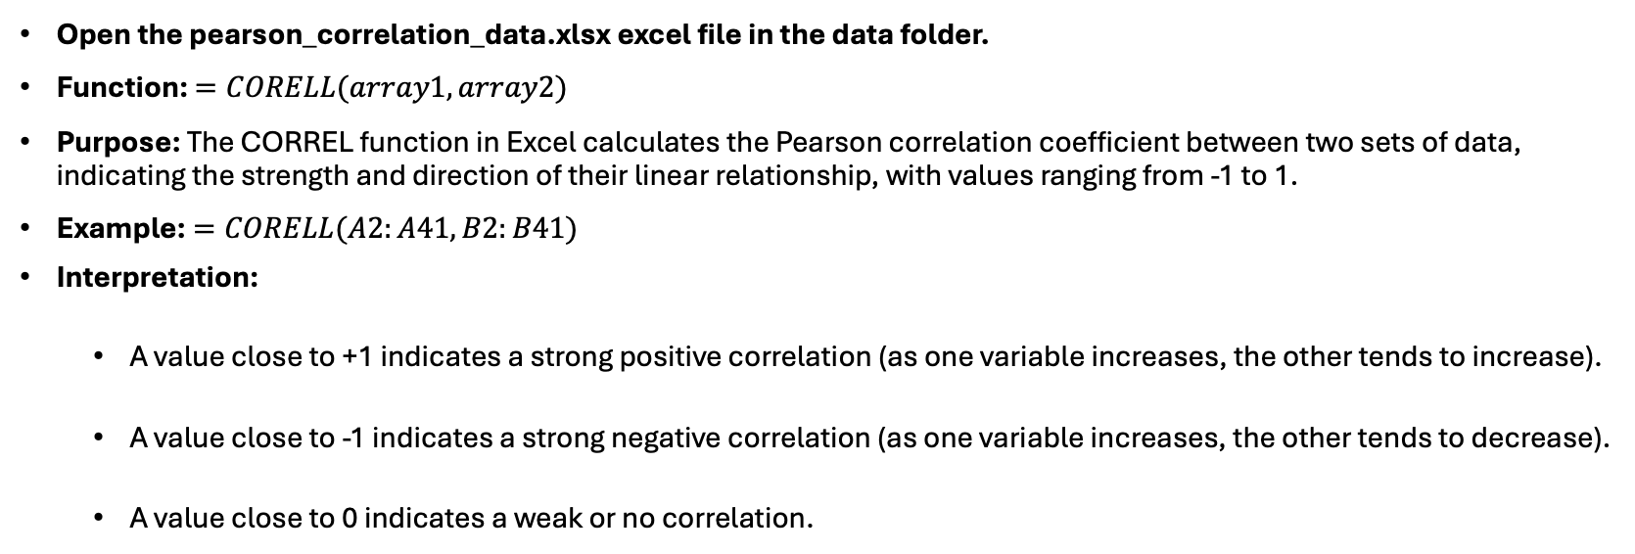
Pearson Correlation Coefficient
Open the pearson_correlation_data.xlsx excel file in the data folder.
Function: $=CORELL(array1,array2)$
Purpose: The CORREL function in Excel calculates the Pearson correlation coefficient between two sets of data, indicating the strength and direction of their linear relationship, with values ranging from -1 to 1.
Example:$=CORELL(A2:A41, B2:B41)$
Interpretation:
A value close to +1 indicates a strong positive correlation (as one variable increases, the other tends to increase).
A value close to -1 indicates a strong negative correlation (as one variable increases, the other tends to decrease).
A value close to 0 indicates a weak or no correlation.

Slide 26
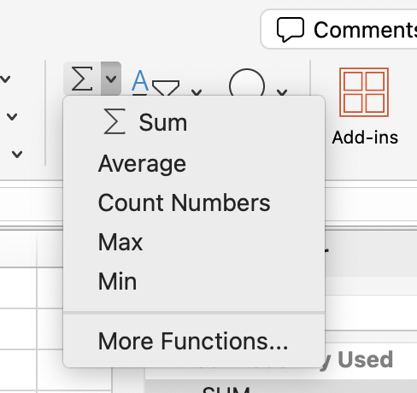
A Simple Shortcut
Using AutoSum option in Excel: Select the cell where you want the sum to appear, click the AutoSum button (Σ) on the Home tab, and Excel will automatically suggest a sum formula based on adjacent cells. Press Enter to apply the formula and display the calculated sum.

Slide 27
Next Lecture
In the next lecture, we focus on how to make common chart types and what their use cases are.

